Slide 1

GO TEAM Meeting: December 4, 2024

Slide 2
Every Child, Every Chance, Every Day!
PBSA and Price Vision and Mission
PBSA Cluster Vision and Mission
Vision : We graduate empowered change agents who create positive, long-lasting impact in their communities.
Mission: We cultivate students’ skills and agency in pursuit of their unlimited potential.
Price Middle School
Vision : Luther J. Price Middle School exists to improve our community by empowering and equipping our students with the skills needed to graduate and live liberated choice-filled lives.
Mission: Students at Price Middle School are empowered through academic acquisition, leadership development, authentic problem solving, and student-centered ownership leading to them reaching their unlimited potential.

Slide 3

Past Events: October
Red Ribbon Week starts 10/23
Oct. 22nd-8th Spanish Trip (11-2:30); Adomah/Duhart
Oct. 22nd-Earthquake Drill
Oct. 24th- Farm Trip (9:15-1:30)
Oct. 24th- Fire Drill Unannounced
October 29th- Carver visit to speak to 8th grade parents
Oct. 30th- 8th PSAT
Oct. 31st-Activate Atlanta (Kitchens)
Oct. 31st-Sunshine Social

Slide 4

Past Events: November
Nov. 7th- Nurse Hardaway distributing eye glasses
Nov. 7th- Perfect Attendance Celebration
Nov. 8th- Harvest Festival (2:30-4:30)
Nov. 8th- Classroom Spelling Bee
Nov. 19th-Passport to Change (7th Grade)
Nov. 21st- Sunshine Social
Nov. 22nd- Grade Level Spelling Bee

Slide 5
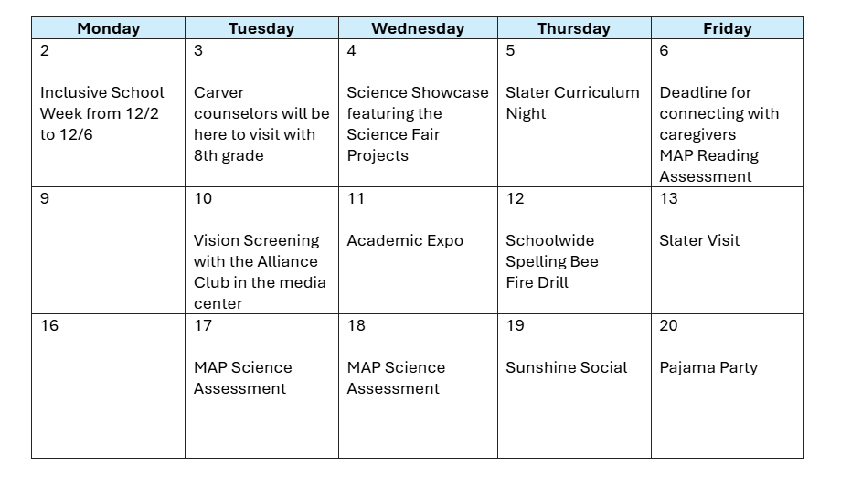

Upcoming Events: December

Slide 6
Data Review

Slide 7
Action Plan#1
Action Steps:
Teachers will:
  take attendance daily in the first 10 minutes of each class period
  Make phone calls home informing caregivers when students have 3 absences
  Compete a SWARM report for students in their homeroom advisory groups with 5 or more absences
School Clerk will:
  Input tardies in IC for students that arrive after 7:45
  Monitor daily attendance per period; inform teachers when attendance has not been taken within the first 10 minutes of each class period.
  Submit list of teachers who do not take attendance during the first 10 minutes to principal.
Goal / Expected Outcome #1:
By May 2025, 75% of students will meet the CCRPI standard for attendance
Timebound, Chunked Goal (Q1):
By October 14, 2024 50% of students will meet the CCRPI standard for attendance
By December 20, 2024 70% of students will meet the CCRPI standard for attendance
School Action Step:
As a school, 100% of students are accounted for daily.
Notes:
–Opportunity to share the vision with teachers and staff.
–Could provide discussion/reflection on how individuals will put the vision into practice.
Ideal Practice/SY24-25 Goal: the vision is developed collaboratively with the teachers and even students providing input.

Slide 8
Action Plan#1 Action Steps Cont……..
Action Steps:
Principal will:
  Meet with teachers regarding attendance regarding information provided by clerk and APS Graphs take rate results.
  Present data results to staff on 4th Fridays
Social Worker will:
  Contact parents of students with 5 or more unexcused absences.
  Co-facilitate, with Dean of Students, meetings with parents of students who have more than 8 absences.
  Pull weekly attendance report for students with 3 or more absences and identify students for which a SWARM report has not been submitted. Submit list to the API.
Action Steps:
API will:
  Obtain weekly attendance report from Social Worker; contact teachers who have past due SWARM reports and call teachers who have not made phone calls home regarding students with 3 absences.
Dean of Culture will:
  Co-facilitate, with social worker, meetings with parents of students who have more than 8 absences.
  Quarterly meetings with students regarding absences based on APS Graph reports.
Notes:
–Opportunity to share the vision with teachers and staff.
–Could provide discussion/reflection on how individuals will put the vision into practice.
Ideal Practice/SY24-25 Goal: the vision is developed collaboratively with the teachers and even students providing input.

Slide 9
Action Plan#1 Quarter 1 Results
School Culture Goal
By May 2025, 75% of students will meet the CCRPI standard for attendances.
Action Steps
The attendance team will hold bi-weekly meetings to do the following:
Review Infinite Campus parent/guardian contact information for accuracy.
Monitor accuracy and consistency of daily teacher attendance (identify staff member who will lead this task)
Ensure daily attendance is taken during the first 10-minutes of each period
Ensure that attendance is updated when students arrive late
Identify daily absences and make phone calls home in an attempt to get students in school.
Implement PBIS strategies to promote positive attendance behaviors, recognize and reinforce attendance-related achievements, and create a supportive school climate that values regular attendance.
Data Results
August: 66% students met the CCRPI for standard attendance
September: 67% students met the CCRPI standard for attendance
October: 62% of students met the CCRPI standard for attendance
November: 62% of students met the CCRPI standard for attendance
Notes:
–Opportunity to share the vision with teachers and staff.
–Could provide discussion/reflection on how individuals will put the vision into practice.
Ideal Practice/SY24-25 Goal: the vision is developed collaboratively with the teachers and even students providing input.

